Slide 1
SDLC & HDLC

Slide 2
Synchronous Data Link Communication (SDLC)
Synchronous Bit Oriented Protocol by IBM.
Simplex/half duplex/full duplex.
Sliding window protocol.
Language EBCDIC.
Data frame 256 characters long.
All data link control functions performed by a single control field.
Master-slave environment only.

Slide 3
The primary station controls data exchange on the communication channel and issues command.
The secondary station receives commands and returns responses to the primary.
Three transmission states:-
Transient state:-before and after the initial transmission and after each line turnaround.
Idle state:- after 15 or more consecutive 1s have been received.
Active state:- whenever either primary or secondary station is transmitting information or control signals.

Slide 4
General frame structure:
Flag | Address | Control | Data… | FCS | Flag
8 bits | 8 bits | 8 bits | Variable multiples of 8 | 16 bits | 8 bits

Slide 5
High-level Data Link Control HDLC
HDLC is a discipline for the management of information transfer over a data communication channel
HDLC has a basic structure that governs the function and the use of control procedures. The basic structure includes:
The definitions of primary and secondary station responsibilities.
The design of information grouping for control and checking.
The design of the format for transfer of information and control data.

Slide 6
Primary and secondary stations
A data link involves two or more participating stations. For control purposes one station on the link is designated a primary station, the others are secondary stations.
The primary station is responsible for the organisation of data flow and for the link level error recovery procedures.
A frame sent from a primary station is referred to as a command frame. A frame from a secondary to a primary is referred to as a response frame.
Normally when a command is sent, a response or a string of responses is expected in reply

Slide 7
HDLC Station Types
Primary station
Controls operation of link
Issues commands (frames)
Maintains separate logical link to each secondary station
Secondary station
Under control of primary station
Issues responses (frames)
Combined station
May issue commands and responses
Combines the features of primary and secondary stations

Slide 8
HDLC Link Configurations
Unbalanced
One primary and one or more secondary stations
Supports full duplex and half duplex
Balanced
Two combined stations
Supports full duplex and half duplex

Slide 9
Frame Structure
Synchronous transmission
All transmissions in frames
Single frame format for all data and control exchanges

Slide 10
Types of frames
There are three kinds of frames:
I-frame: Information frame: This type of frame carries user’s data.
S-frame: Supervisory frame: used for error and flow control.
This is used for supervisory control functions such as acknowledgements, requesting transmission and requesting a temporary suspension of transmission.

Slide 11
U-frame: Unnumbered frame or Unsequenced frame:
Unnumbered frames are used for link management. This is used to provide additional link control functions.
Used to set up the logical link between the primary station and a secondary station
To inform the secondary station about the mode of operation which is used.

Slide 12
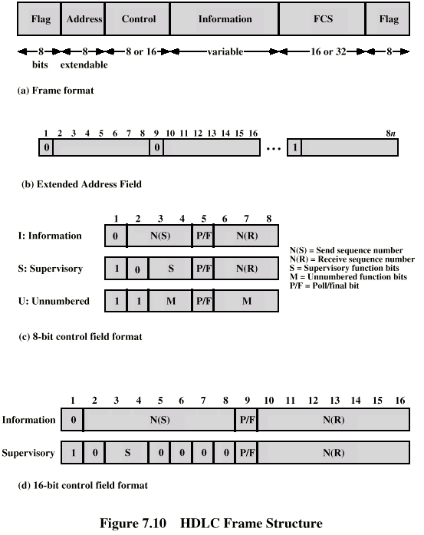
Frame Structure
Defines 3 types of frames (I,S,U frames)
01111110
01111110

Slide 13
Flag Fields
Delimit frame at both ends
01111110
Receiver hunts for flag sequence to synchronize
Bit stuffing used to avoid confusion with data containing 01111110
The transmitter inserts 0 bit after every sequence of five 1s with the exception of flag fields
If receiver detects five 1s it checks next bit
If 0, it is deleted
If 1 and seventh bit is 0 (i.e., 10), accept as flag
If sixth and seventh bits 1 (i.e., 11), sender is indicating abort

Slide 14
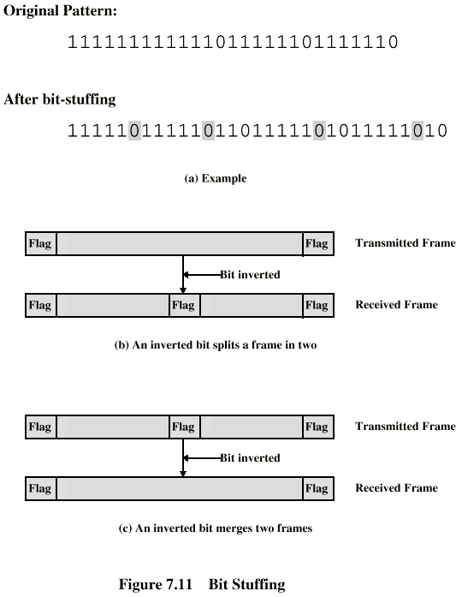
Bit Stuffing
Example with possible errors

Slide 15
Address Field
Identifies secondary station that sent or will receive frame
Usually 8 bits long
May be extended to multiples of 7 bits
LSB of each octet indicates that it is the last octet (1) or not (0)
All ones (11111111) is broadcast

Slide 16
Control Field
Different for different frame type
I-frame (information frame)
data to be transmitted to user (next layer up)
Flow and error control piggybacked on information frames
S-frame (Supervisory frame)
Used for flow and error control
U-frame (Unnumbered frame)
supplementary link control
First one or two bits of control filed identify frame type

Slide 17
Control Field Diagram

Slide 18
Poll/Final Bit
Use depends on context
Command frame
P bit : used for poll from primary
1 to solicit (poll) response from peer
Response frame
F bit : used for response from secondary
1 indicates response to soliciting command

Slide 19
I-frame
Contains the sequence number of transmitted frames and a piggybacked ACK
1 2 3 4 5 6 7 8
0
N(S)
P/F
N(R)
I,0,0
I,1,0
I,2,0,P

Slide 20
S-frame
Used for flow and error control
1 2 3 4 5 6 7 8
1
0
S
P/F
N(R)
RR --- receive ready
RNR --- receive not ready
REJ --- reject on frame N(R)
SREJ --- selective reject on N(R)

Slide 21
U-frame
Mode setting, recovery, connect/diconnect
1 2 3 4 5 6 7 8
1
1
M
P/F
M
Unnumbered function bits

Slide 22
Unnumberred frames
Set normal response mode (SNRM)
Set asynchronous response mode (SARM)
Set asynchronous balanced mode (SABM)
Disconnect (DISC)
Unnumberred acknowledgement (UA)
Disconnect mode (DM)
Request disconnect (RD)
Unnumberred poll (UP)
Reset (RSET)
Exchange identification (XID)
Test (TEST)
Frame reject (FRMR)

Slide 23
Information Field
Only in information and some unnumbered frames
Must contain integral number of octets
Variable length

Slide 24
Frame Check Sequence Field
FCS
Error detection
16 bit CRC
Optional 32 bit CRC

Slide 25
Data link channel states
Active channel state:
A channel is in an ACTIVE state when the primary or a secondary is actively transmitting a frame, a single abort sequence or interframe time fill. In this state the right to continue transmission is reserved.
Abort:
A station can abort a frame by transmitting at least seven contiguous ones. The receiving station will ignore the frame.
Interframe time fill:
In this state continuous flag bytes are sent between frames.
Idle channel state:
A channel is defined to be in an IDLE state when the transmission of 15 or more contiguous one bits is detected. In this state a primary must repoll a secondary before transmitting an I-frame to it.

Slide 26
Modes of operation
Normal response mode
In this mode a secondary station can transmit only in response to a command frame from the primary station.
The response transmission may consist of one or more frames, the last of which must be explicitly indicated (using the Poll/Final bit).
The secondary then cannot transmit again until it receives another command to do so.

Slide 27
Asynchronous Response Mode (ARM)
In this mode the secondary station may initiate transmission of a frame or group of frames without receiving explicit permission from the primary.
The frames may contain data or control information.
The secondary station is responsible for time-out and retransmission if necessary.
Asynchronous Balanced Mode (ABM)
In this mode the stations have identical protocols. They both can initiate transmission at any time.
They can send both commands and responses.

Slide 28
HDLC Operation
Exchange of information, supervisory and unnumbered frames
Three phases
Initialization
Data transfer
Disconnect

Slide 29
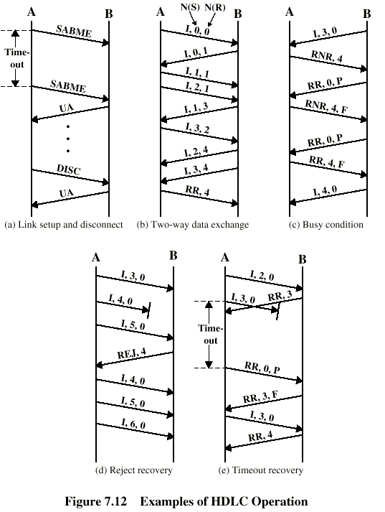
Examples of Operation (1)

Slide 30
Examples of Operation (2)

Slide 31
SLIP & PPP

Slide 32
Internet consists of individual systems that are connected to each other.
Basically, it is wide area network that is built up from point-to-point leased lines.
In these point-to-point lines, two major data link protocols are used:
Serial Line Internet Protocol (SLIP)
Point-to-Point Protocol (PPP)

Slide 33
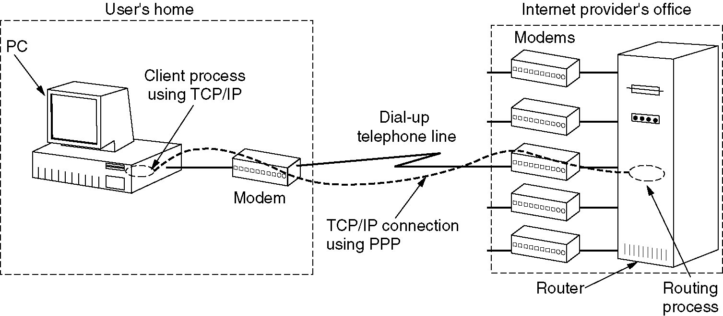
The Data Link Layer in the Internet
A home personal computer acting as an internet host.

Slide 34
Serial Line Internet Protocol (SLIP)
It is a means of sending Internet Protocol datagrams over a serial link.
It can be used by two systems to communicate via a direct cable connection or modem link.
The initial purpose of this protocol was to connect Sun workstation to the Internet over a dial-up line using modem.

Slide 35
Data Format of SLIP
The data format of SLIP is:
A special END character (equivalent to decimal 192) marks the end of data.

Slide 36
Framing Rules
The IP datagram is terminated by the special character called END (0xc0)
Most implementations transmit an END character at the beginning of the datagram to prevent any line noise.
If a byte of IP datagram equals END character, then 2 –byte sequence 0xdb 0xdc (SLIP ESC) is transmitted instead.
If a byte of IP datagram equals SLIPESC character , then 2 –byte sequence 0xdb, 0xdd is transmitted instead.

Slide 37
Problems with SLIP
It does not perform any error detection and correction. No checksum is added to the frame.
It supports only IP (Internet Protocol). So, it cannot be used for other networks that do not use IP (for e.g.: Novell LANs).
It does not support the allocation of dynamic IP address. There is no method to inform a node’s IP address to the other nodes
Both the communicating systems should be assigned a specific IP address before hand.
It does not provide any authentication.
It is not an approved Internet standard.

Slide 38
Compressed SLIP
Since SLIP is slow (19200 bits/sec) and frequently used for interactive traffic(TELNET, RLOGIN), there may be small TCP packets exchanged across a SLIP line. (i.e., to carry a 1 byte of data , 20 bytes of IP header and 20 bytes of TCP header are needed.)
Compressed SLIP reduces the 40 byte header to 3 or 5 bytes. Some of the fields in the headers do not change frequently are compressed.
CSLIP maintains the state of 16 TCP connections

Slide 39
Point-to-Point Protocol (PPP)
PPP was devised by IETF (Internet Engineering Task Force) to create a data link protocol for point-to-point lines that can solve all the problems of SLIP.
It is the most commonly used data link protocol.
It is used in dial up connection to connect the home PC to the ISP server.
Point to point, wired data link easier to manage than broadcast link: no Media Access Control
PPP is extremely simple (the simplest in the Data Link protocol family) and very streamlined

Slide 40
PPP requirements
Packet framing: encapsulation of packets
bit transparency: must carry any bit pattern in the data field
error detection (no correction)
multiple network layer protocols
connection liveness
Network Layer Address negotiation: Hosts/nodes across the link must learn/configure each other’s network address

Slide 41
PPP non-requirements
error correction/recovery
flow control
sequencing
multipoint links (eg, polling)

Slide 42
Benefits of PPP
PPP defines the format of the frame to be exchanged between the devices.
It defines Link Control Protocol (LCP) for
Establishing the link between two devices.
Maintaining this established link.
Configuring this link.
Terminating this link after the transfer.

Slide 43
It provides error detection.
Unlike SLIP, that supports only IP, it supports multiple protocols.
It supports dynamic allocation of IP address.
It provides authentication.
It provides NCP (Network Control Protocol), that supports variety of network layer protocol.

Slide 44
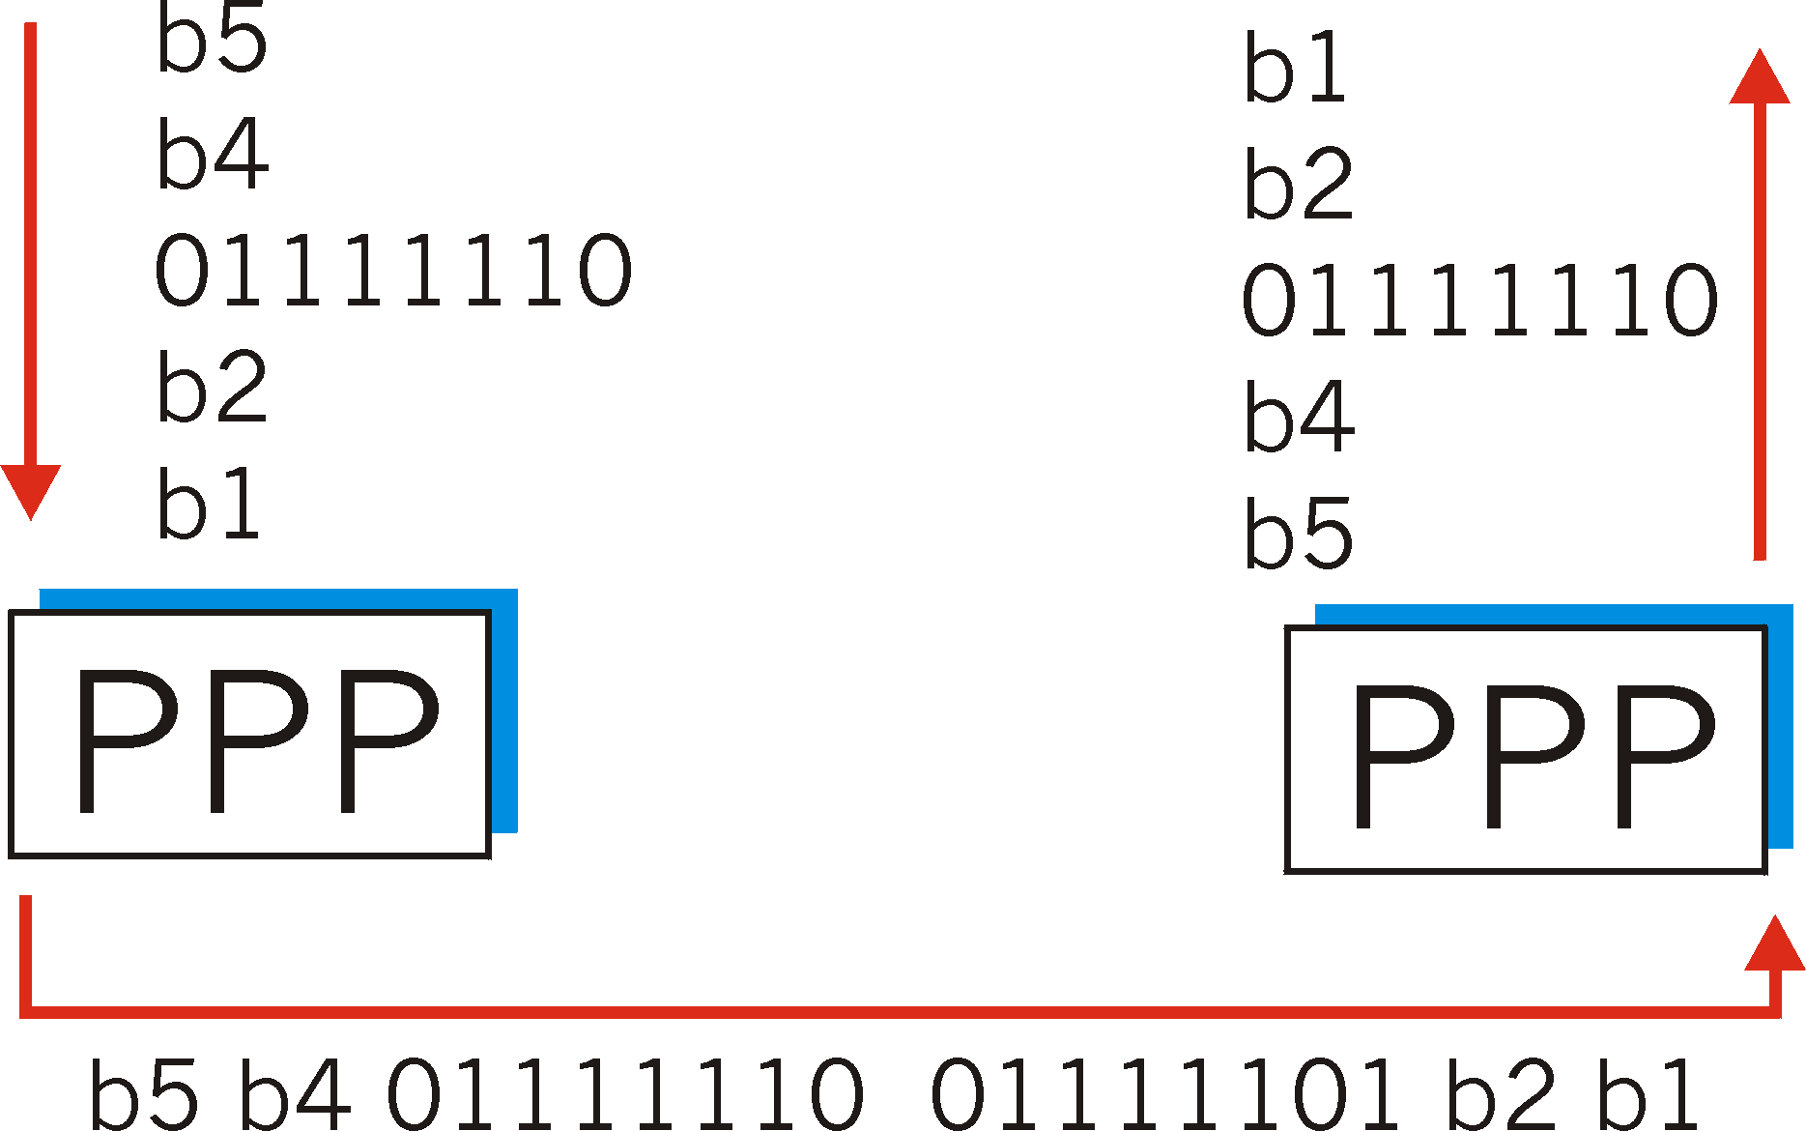
Byte Stuffing
For “data transparency”, the data field must be allowed to include the pattern <01111110> ; ie, this must not be interpreted as a flag
to alert the receiver, the transmitter “stuffs” an extra < 01111101> byte after each < 01111110> data byte
the receiver discards each 01111101 after 01111110, and continues data reception

Slide 45
PPP Frame Format
Frame format of PPP is similar to HDLC frame:
Flag Field: It marks the beginning and end of the PPP frame. Flag byte is 01111110.

Slide 46
Address Field: This field is of 1 byte and is always 11111111. This address is the broadcast address i.e. all stations accept this frame.
Control Field: It is also of 1 byte. It uses the format of U-Frame in HDLC. The value is always 00000011 to show that the frame does not contain any sequence number and there is no flow control or error control.
Protocol Field: This field specifies the kind of protocol of the data in the information field.
Information Field: Its length is variable. It carries user data or other information.
FCS Field: It stands for Frame Check Sequence. It contains checksum. It is either 2 bytes or 4 bytes.

Slide 47
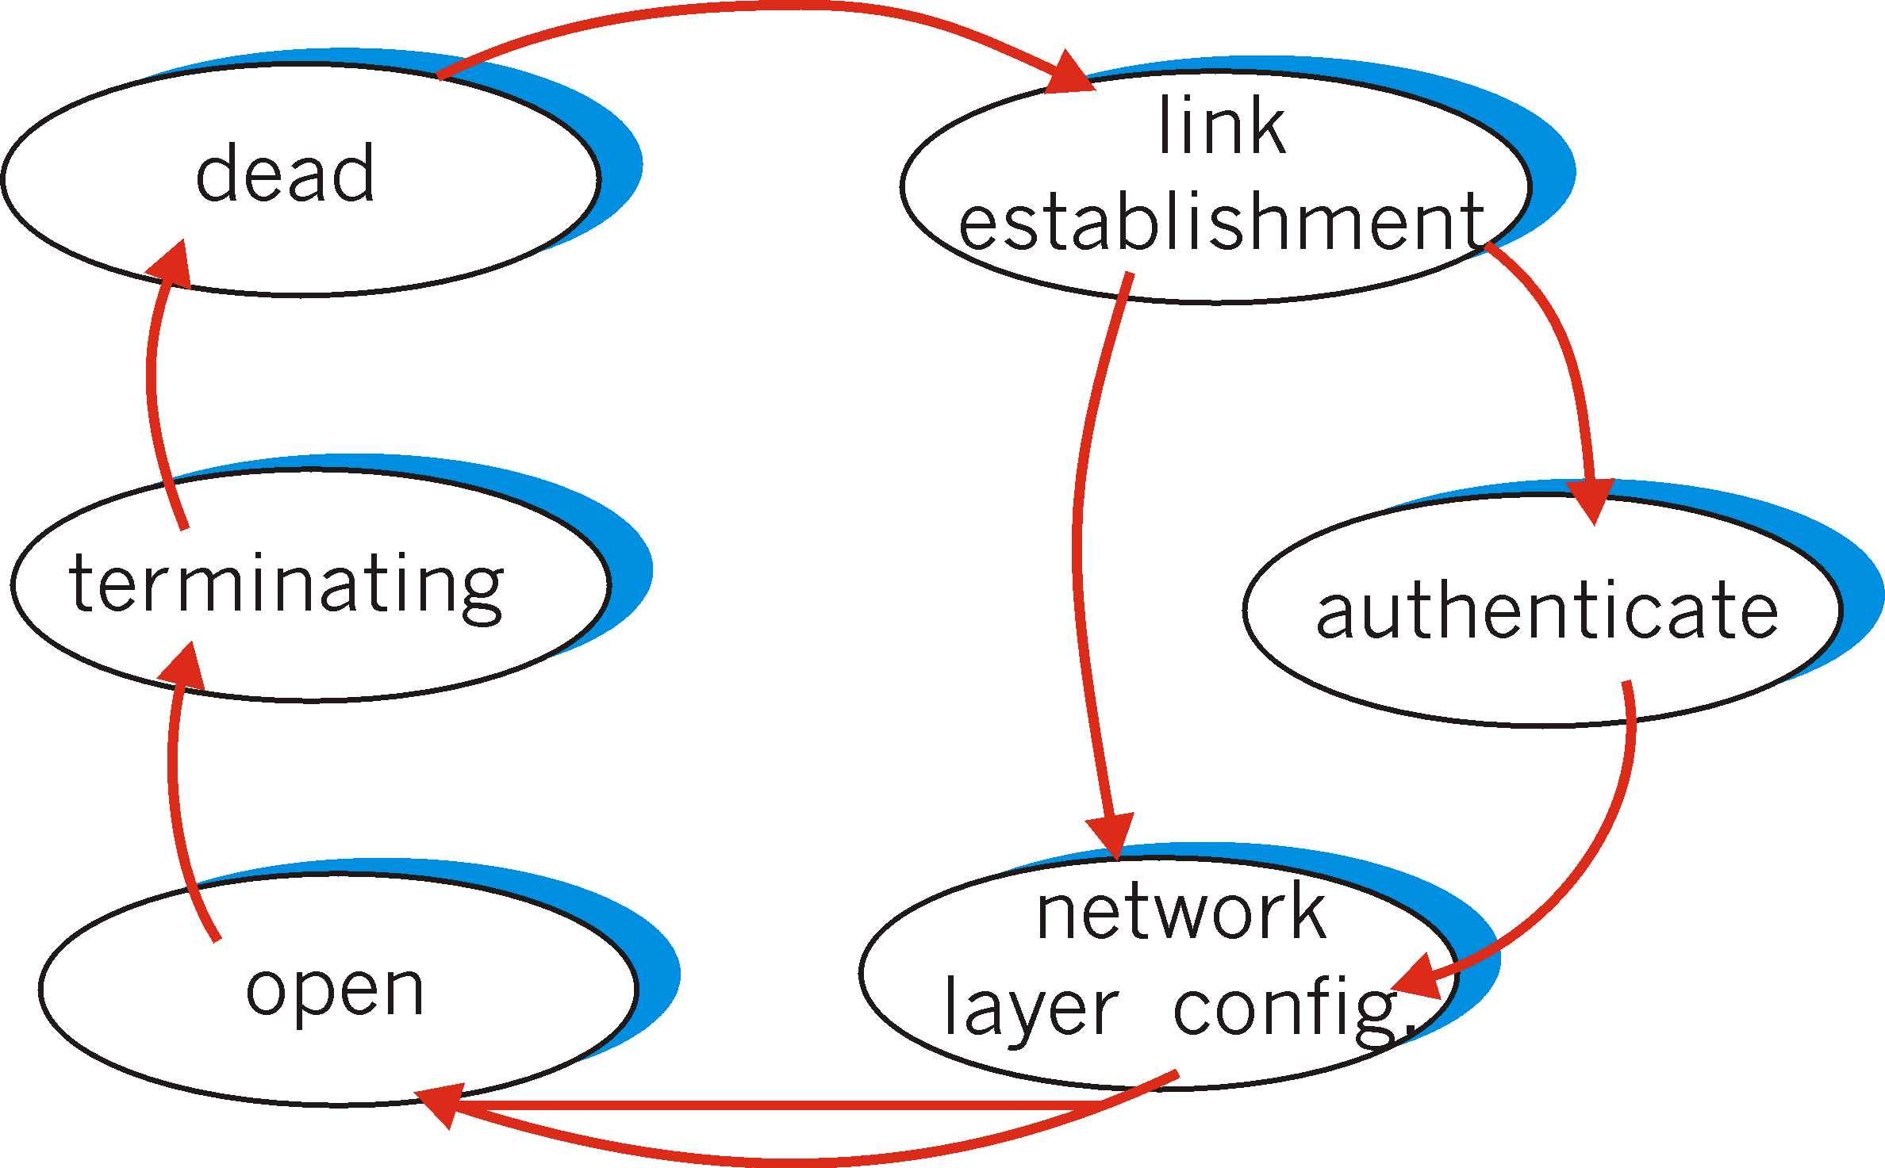
PPP Link Control Protocol
PPP-LCP establishes/releases the PPP connection; negotiates options
Starts in DEAD state
LCP Options: max frame length; authentication protocol
Once PPP link established, IP-CP (Contr Prot) moves in (on top of PPP) to configure IP network addresses etc.

Slide 48
Transition Phases in PPP
The PPP connection goes through different states:

Slide 49
Transition Phases in PPP
Down:
In down phase, the link is not used.
Establish:
Connection goes into this phase when one of the nodes start communication.
Authenticate:
This phase is optional. The two nodes may decide during establishment phase, to use this phase

Slide 50
Up:
In this phase, data transfer takes place. The connection remains in this phase until one of the node wants to end the connection.
Terminate:
In this phase, connection is terminated.

Slide 51
PPP Stack
PPP uses several other protocols to establish link, authenticate users and to carry the network layer data
The various protocols used are:
Link Control Protocol
Authenticate Protocol
Network Control Protocol

Slide 52
Link Control Protocol
It is responsible for establishing, maintaining, configuring and terminating the link.
It provides negotiation mechanism to set options between two nodes.
All LCP packets are carried in the information field of the PPP frame.

Slide 53
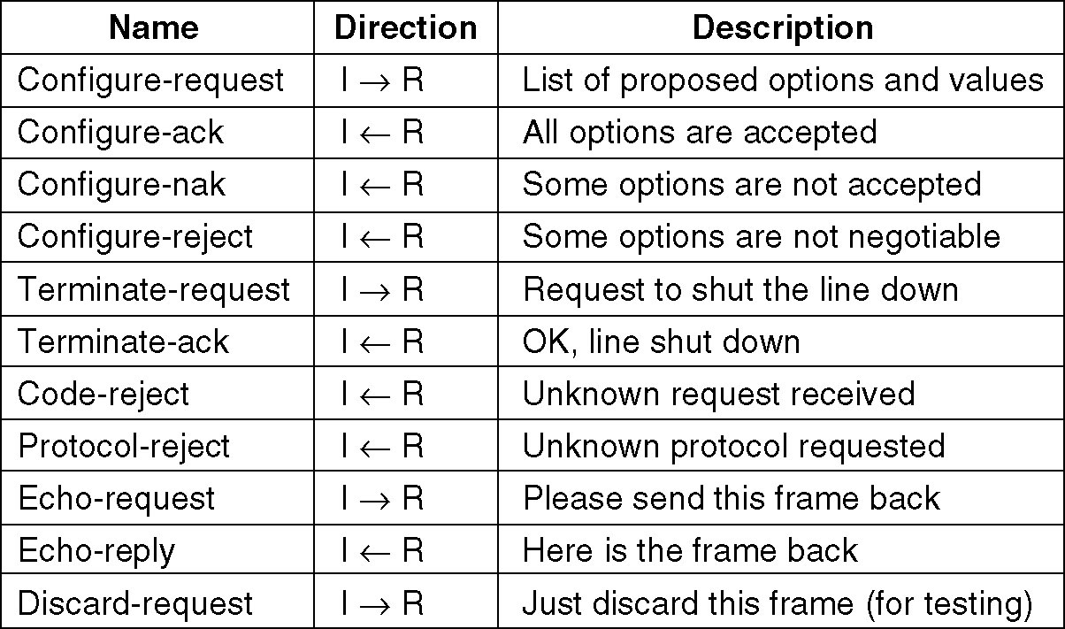
PPP – Point to Point Protocol
The LCP frame types.

Slide 54
Authentication Protocol
Authentication protocol helps to validate the identity of a user who needs to access the resources.
There are two authentication protocols:
Password Authentication Protocols (PAP)
Challenge Handshake Authentication Protocol (CHAP)

Slide 55
Password Authentication Protocol (PAP)
This protocol provides two step authentication procedure:
Step 1: Username and password is provided by the user who wants to access the system.
Step 2: The system checks the validity of username and password, and either accepts or rejects the connection.

Slide 56
Challenge Handshake Authentication Protocol (CHAP)
It provides more security than PAP. In this method, password is kept secret. It is a three way authentication protocol:
Step 1: System sends a challenge packet to the user. It contains a value, usually a few bytes.
Step 2: Using a predefined function, a user combines this challenge value with the user password and sends the resultant packet back to the system.
Step 3: System then applies the same function to the password of the user & challenge value, and creates a result. If the result is same as the result sent in the response packet, access is granted, otherwise, it is denied.

Slide 57
Network Control Protocol (NCP)
After establishing the link & authenticating the user, PPP connects to the network layer.
This connection is established by NCP. Therefore, NCP is a set of control protocols that allow the encapsulation of the data coming from the network layer.
After the network layer configuration is done by one of the NCP, the user can exchange data from the network layer.

Slide 58
Differences Between SLIP & PPP

